Slide 1
Animate PowerPoint Table
A macro by
Dr Nitin Paranjape and Raj Chaudhuri

Slide 2
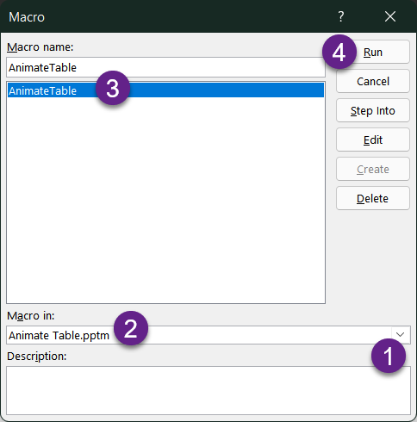
How to use this macro?
Keep this file open
Go to your presentation
Select a single table
From View menu choose Macros
Run the macro AnimateTable
If you cannot see the macro, choose All presentations from the Macro In dropdown.

Slide 3
Results of the macro
Before – original table
After – Split and animated table
Jan | Feb
13 | 43
84 | 95
NA | >100
Jan
Feb
13
43
84
95
NA
>100
When you run the macro, the original table will be hidden. Here it is made visible for easy comparison.

Slide 4
Test Cases
These slides contain various test cases.
You can try the macro on these tables to test it out.

Slide 5
Running tests
Go to a test slide
Select the table on the slide
Run the macro

Slide 6
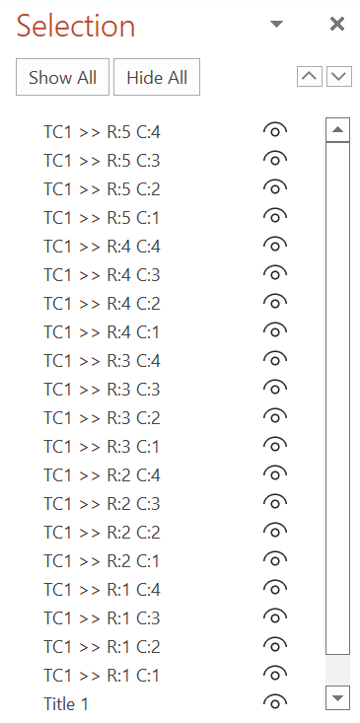
Resetting tests
Once the macro runs, the original table is hidden.
The macro creates tables with names like “TC1 >> R:1 C:1”
To reset a test slide after testing:
  Go to Home tab – Selection – Selection Pane. Choose Show All.
  Select and delete the shapes named as described above
  Alternatively, press Ctrl+Z to undo immediately after running the macro

Slide 7
Simple table
H1C1 | H1C2 | H1C3 | H1C4
R2C1 | R2C2 | R2C3 | R2C4
R3C1 | R3C2 | R3C3 | R3C4
R4C1 | R4C2 | R4C3 | R4C4
R5C1 | R5C2 | R5C3 | R5C4

Slide 8
Merged cells
H1C1 | H1C2 | H1C3 | H1C4
R2C1 | R2C2 | R2C3 | R2C4
R3C1 | R3C2 | R3C3
R4C1 | R4C2

Slide 9
Merged Rows
H1C1 | H1C2 | H1C3 | H1C4
R2C1 | R2C2 | R2C3 | R2C4
R3C1 | R3C2 R3C3 | R3C3 | R3C4
R4C1 | R4C2 | R4C3 | R4C4
R5C1 | R5C2 | R5C3 | R5C4

Slide 10
Split cells
H1C1 | H1C2 |  | H1C3 | H1C4
R2C1 | R2C2 |  | R2C3 | R2C4
R3C1 | R3C2.1 | R3C2.2 | R3C3 | R3C4
R4C1 | R4C2 |  | R4C3 | R4C4
R5C1 | R5C2 |  | R5C3 | R5C4

Slide 11
Merge and Split
H1C1 | H1C2 | H1C3 | H1C4
R2C1 | R2C2 | R2C3 | R2C4
R3C1 | R3.1C2 | R3C3 | R3C4
 | R3.2C2
R4C1 | R4C2 | R4C3 | R4C4
R5C1 | R5C2 | R5C3 | R5C4

Slide 12
Merge and Split variation
H1C1 | H1C2 |  | H1C3 | H1C4
R2C1 | R2C2 |  | R2C3 | R2C4
R3C1 | R3.1C2.1 | R3.1C2.2 | R3C3 | R3C4
 | R3.2C2.1 | R3.2C2.2
R4C1 | R4C2 |  | R4C3 | R4C4
R5C1 | R5C2 |  | R5C3 | R5C4

Slide 13
Merge and Split variation
H1C1 | H1C2 | H1C3 | H1C4
R2C1 | R2C2 | R2C3 | R2C4
R3C1 | R3C2 R3C3 R4C2 R4C3 | R3C3 | R3C4
R4C1 | R4C2 | R4C3 | R4C4
R5C1 | R5C2 | R5C3 | R5C4

Slide 14
Merged with header
H1C1 H1C2 H1C3 R2C1 R2C2 R2C3 R3C1 R3C2 R3C3 | H1C2 | H1C3 | H1C4
R2C1 | R2C2 | R2C3 | R2C4
R3C1 | R3C2 | R3C3 | R3C4
R4C1 | R4C2 | R4C3 | R4C4
R5C1 | R5C2 | R5C3 | R5C4

Slide 15
Non-default style
67 | 135 | 156 | 313 | 153 | 164 | 319 | 320
3 | 193 | 228 | 20 | 14 | 65 | 348 | 148
321 | 11 | 41 | 330 | 345 | 267 | 334 | 308
33 | 347 | 341 | 382 | 163 | 385 | 186 | 270
34 | 259 | 231 | 62 | 399 | 266 | 290 | 11
90 | 57 | 331 | 293 | 388 | 138 | 357 | 314
111 | 59 | 135 | 140 | 373 | 370 | 304 | 367
244 | 338 | 392 | 274 | 388 | 135 | 368 | 89
322 | 84 | 29 | 340 | 6 | 87 | 252 | 174
313 | 58 | 117 | 116 | 1 | 112 | 89 | 154
159 | 392 | 228 | 150 | 350 | 257 | 144 | 248

Slide 16
Merge with custom formatting
H1C1 | H1C2 | H1C3 | H1C4
R2C1 | R2C2 | R2C3 | R2C4
R3C1 | R3C2 | R3C3 | works
R4C1 | R4C2 | R4C3 | R4C4
R5C1 | R5C2 | R5C3 | R5C4

Slide 17
Gradients and borders
 | Demo

Slide 18
Thank you

